Slide 1



Bank of Baroda Hackathon - 2022
Technology Partner
Team Name : CAGE Decoders
Team Bio :
Date : 20.9.2022
Calvin Davis S.R 312421104028
Annlyn Bright A 312421104016
Gowdham M 312421104044
Eugine Carmel P 312421104039

Slide 2

Problem Statement?
Getting video analytics of different parameters from the video recording will help us to resolve many operational issues at the branches.
So, We decided to access & maintain prior security infrastructures and a safe environment for the users and the workers by video analysis.
To enhance surveillance by AI and machine leaning environments in order to make India a Digital India

Slide 3
User Segment & Pain Points
In initial stage the progress of the prototype may vary with peoples needs and usages
Medical sectors
Commercial sectors
Business sectors
Even in the field of sports sectors this prototype can be adopted in order to avoid malpractices.
Why because, the data’s can be easily accessed in business and commercial sectors it can be a better option for the users.

Slide 4

Pre-Requisite
If future applications such as virtual banking experience like meta platform, online banking sytems might reduce the software’s utility and the ease of use.

Slide 5
Azure tools or resources
Face API - Detect, Recognize, and Analyse human faces Power apps - Build apps for any device Cloud storage services - To store data These are the azure tools and resources which are likely to be used in implementation of the prototype.

Slide 6
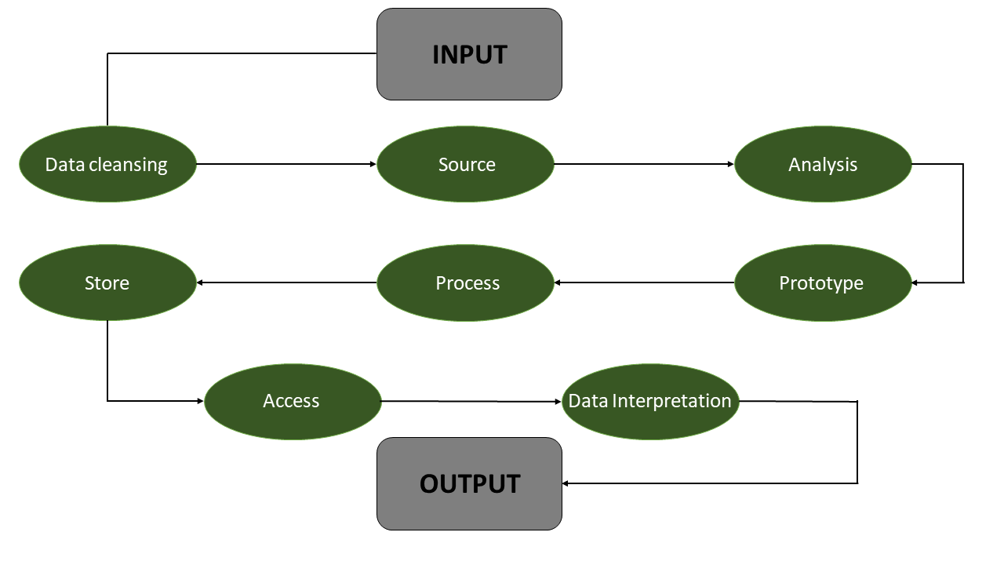
Any Supporting Functional Documents
Analyzes the emotions of the individual and obtains a detailed data in order to improve the user interface and service provided by the corresponding sectors.
Datas that are detaily surveillanced are processed under machine algorithms and the predefined librarires in order to get a detailed sketch of the individuals sentiments.

Slide 7
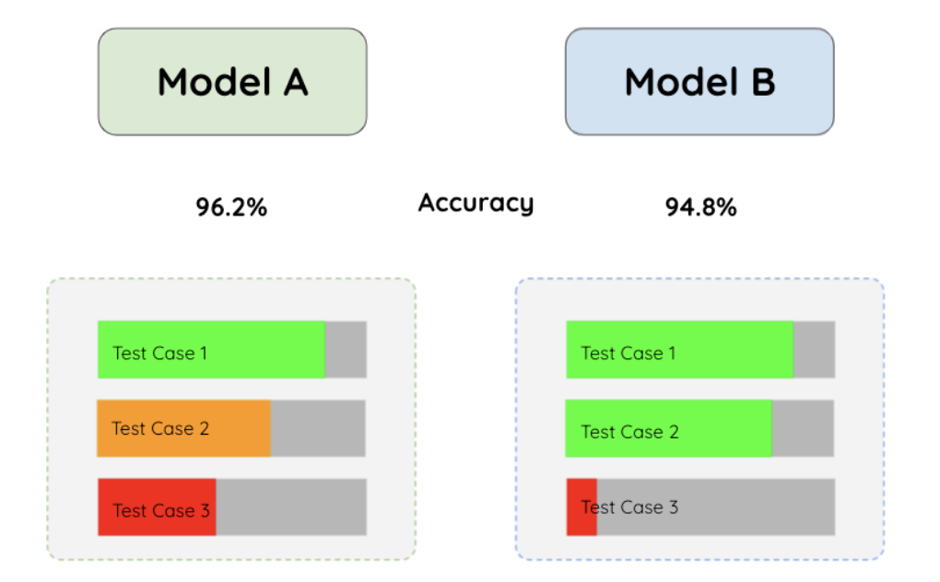
Key Differentiators & Adoption Plan
The number of test cases that can be accomplished can yield more accuracy.
When test cases are accomplished the build adoption process can be achieved easily.

Slide 8
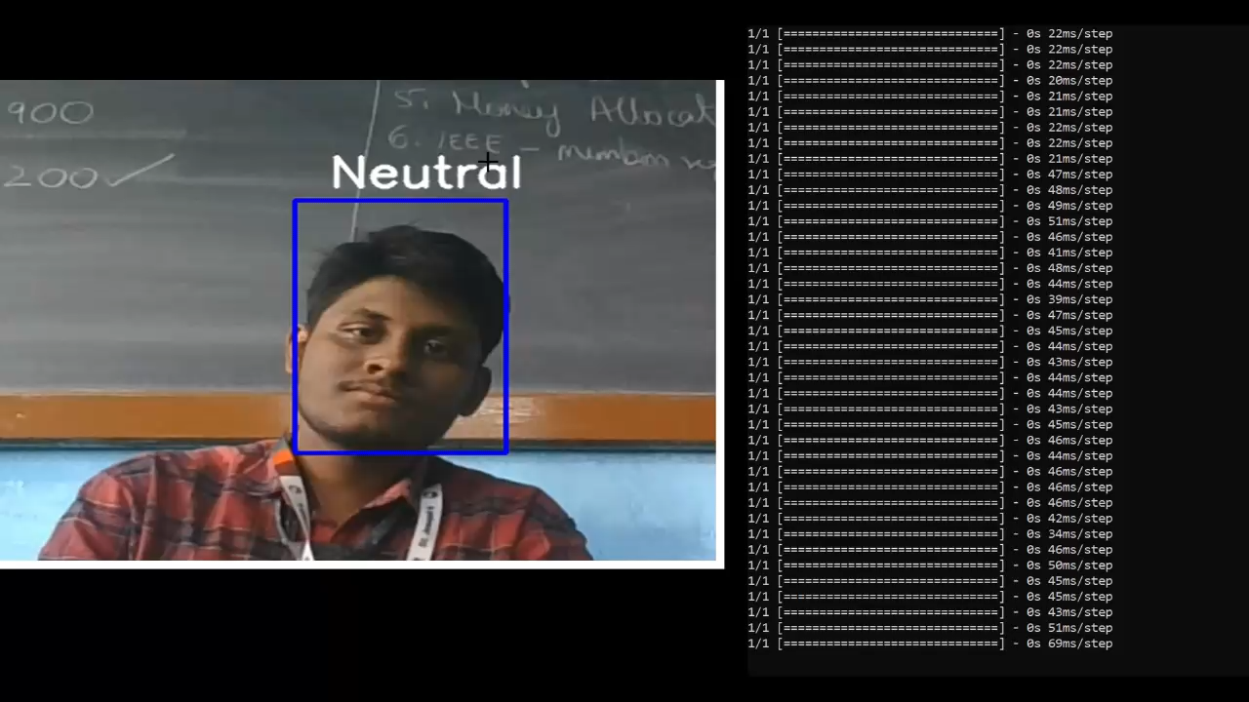
GitHub Repository Link & supporting diagrams, screenshots, if any
https://github.com/cagedecoders/bobhackathon
Refer the above github Repository link for our prototype and detailed review of the project..

Slide 9
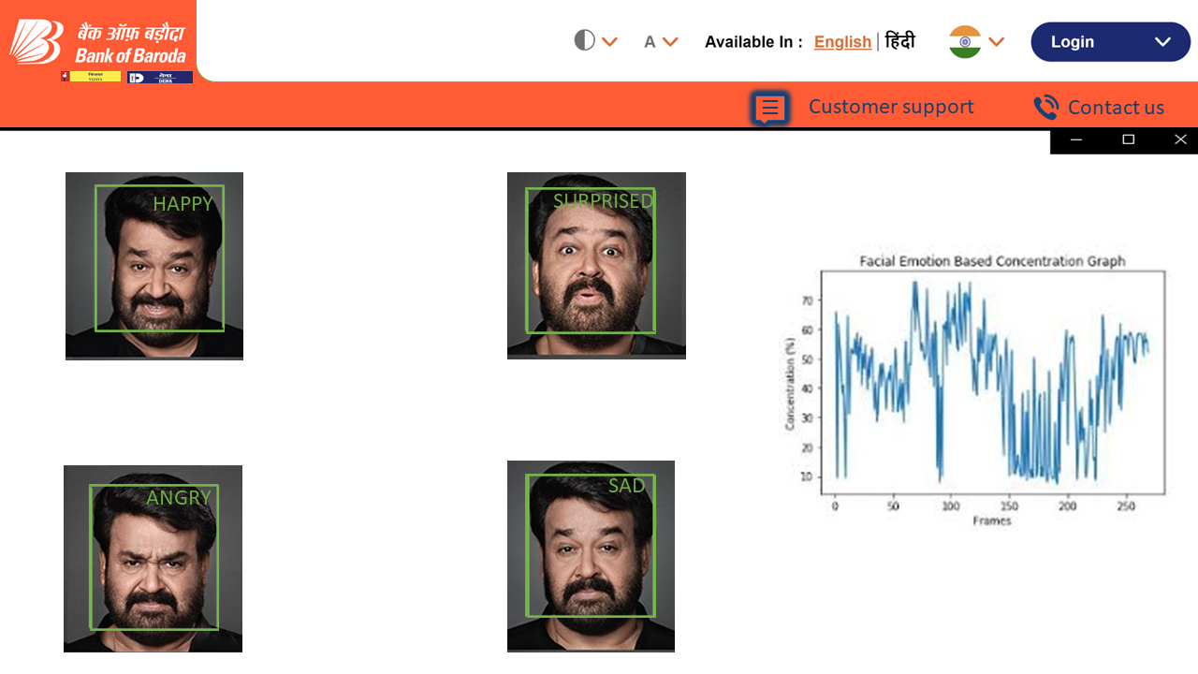

Slide 10
Thank You
python emotions.py --mode display
Calvin Davis S.R
Annlyn Bright .A
Gowdham M
Eugine Carmel .P

